Slide 1


Financial Analysis of Techfin Solutions
The purpose of this financial analysis is to provide a comprehensive overview of TechFin Solutions' financial standing, goals, and challenges.
by Hammad Haroon Shah

Slide 2


Introduction
TechFin Solutions, a dynamic technology and finance company, aims to maintain and enhance its financial stability and growth in the coming fiscal year.

Slide 3
Financial Goals
TechFin Solutions has set clear objectives, including achieving steady revenue growth, optimizing cost structures, and expanding market share.

Slide 4
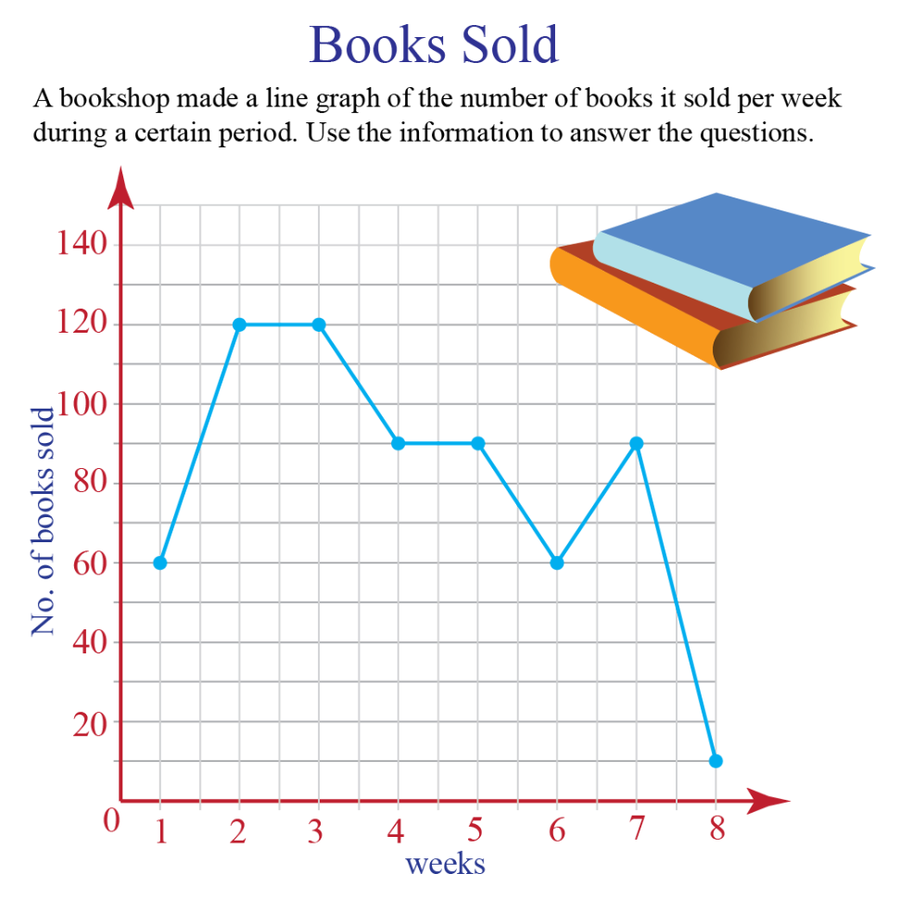
Charts Integration for Financial Data Representation
Through line charts and bar charts, the financial data will be visually presented to gain insights into TechFin Solutions' performance.
Bar Chart
Line Chart

Slide 5
Charts Integration for Financial Data Representation
Through line charts and bar charts, the financial data will be visually presented to gain insights into TechFin Solutions' performance.
Line Chart
Line Chart

Slide 6

Insights and Recommendations
The analysis will provide a deeper understanding of TechFin Solutions' financial performance, identifying strengths and weaknesses. Recommendations will be offered for enhanced performance and revenue growth.

Slide 7

Conclusion
This document serves as the foundation for an upcoming financial presentation, providing essential context, goals, challenges, and an overview of the data to be analyzed.

